Slide 1
Quality Models

Slide 2
GE model (MacCall 1977&1980)
McCall model
•1978, James McCall
•Project manager at General Electric
Three area addressed by MacCall model.
Product operation.
Product revision.
Product transition.

Slide 3
Cont….
Product Revision
Product Transition
Maintainability
Flexibility
Testability
Portability
Reusability
Interoperability
Product Operation
Correctness, Efficiency, Integrity, Reliability, Usability

Slide 4
Cont…
Product Operation:
Here factors are related to the Operational performance, convenience, ease of usage and correctness.
Product Revision:
These factors pertain to the Testing and Maintainability of Software. It gives idea about maintenance, flexibility and Testing effort
Product Transition:
To transfer a product from one platform to another platform or from one technology to another technology.

Slide 5
Cont…
Usability: Ease of use of software.
Integrity: Protection of the program from
unauthorized user access.
Efficiency: concerned with the resources.
(ex): Process time, storage.
Correctness: The extent to which the program fulfills its specifications.
Reliability: Ability not to fail.

Slide 6
Cont…
Maintainability: The effort required locating an fixing a fault in the program with its operating environment.
Flexibility: Ease of making changes with its operating environment.
Testability: Ease of testing the program to ensure that it is error free.

Slide 7
Cont…
Portability: The effort to transfer a program from one environment to another.
Reusability: The ease of using the software in different context.
Interoperability: It is the effort required to couple the system to another system.

Slide 8
Quality Frameworks
Various models or frameworks have been proposed to accommodate these different quality views and expectations,
Define quality and related attributes, features, characteristics, and measurements.
ISO-9 126 (ISO, 2001), the mostly influential one in the software engineering community today, and discuss various adaptations of such quality frameworks for specific application environments.
Causal relationship from intangible quality views to tangible software measures

Slide 9
Quality Standards and Frameworks
Two approaches to software that can be followed to ensure software quality:
  Process based: assurance of the process by which a product is developed (ISO 9001, ISO 9000-3 provides guidelines for the application of the ISO 9001)
  Product based: the evaluation of the quality of the end product (ISO 9126).
Both approaches are important and both require the presence of a system for managing quality.

Slide 10
ISO-9126 Quality Framework
ISO 9126 is the software product evaluation standard from International Organization for Standardization (ISO)
ISO-9126 is the most influential one in the Software Engineering community
ISO-9126 provides a hierarchical framework for quality definition, organized into quality characteristics and sub-characteristic
Characteristics of quality software product (with minimal overlap).
There are six top-level quality characteristics, with each associated with its own exclusive (non-overlapping) sub-characteristics

Slide 11
ISO-9126 Quality Framework
Functionality: A set of attributes that bear on the existence of a set of functions and their specified properties. The functions are those that satisfy stated or implied needs. The sub-characteristics include:
  Suitability- to the user’s needs
  Accuracy- of results
  Interoperability- with other systems
  Security- against unintended access
Reliability: A set of attributes that bear on the capability of software to maintain its level of performance under stated conditions for a stated period of time. The sub-characteristics include:
  Maturity- frequency of failures
  Fault Tolerance- performance in case of faults
  Recoverability- of functionality and data loss

Slide 12
ISO-9126 Quality Framework
Usability: A set of attributes that bear on the effort needed for use, and on the individual assessment of such use, by a stated or implied set of users. The sub characteristics include:
    Understandability
    Learnability
    Operability
Efficiency: A set of attributes that bear on the relationship between the level of performance of the software and the amount of resources used, under stated conditions. The sub-characteristics include:
    Time behavior
    Resource behavior

Slide 13
ISO-9126 Quality Framework
Maintainability: A set of attributes that bear on the effort needed to make specified modifications. The sub-characteristics include:
      Analyzability- effort for diagnosis
      Changeability- ease of modification
      Stability- after change
      Testability- effort required for testing after change
Portability: A set of attributes that bear on the ability of software to be transferred from one environment to another. The sub-characteristics include:
      Adaptability
      Installability
      Conformance
      Replaceability

Slide 14
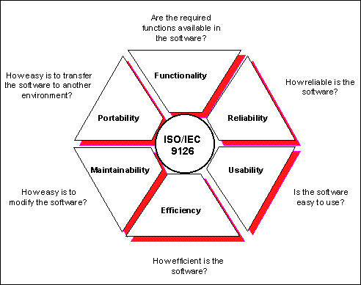
ISO-9126 Quality Characteristics
Notes:
definition of the quality characteristics
associated quality evaluation process
intended to be exhaustive.

Slide 15
ISO-9126: Business Benefits
For the purchaser:
  understand clearly his/her requirements for the product to be developed, and
  Communicate the same
For the supplier:
  understand the requirement, and
  assess with confidence whether it is possible to provide the product with the right level of software quality.
Eliminate any misunderstanding between purchaser and supplier.

Slide 16
ISO-9126: Guidelines for Using the Quality Characteristics
An evaluation process model with 3 stages:-
Quality requirements definition
  takes as input a set of stated or implied needs, relevant technical documentation and the ISO Standard itself
  produces a quality requirement specification.
Evaluation preparation
  involves the selection of appropriate metrics, a rating level definition and the definition of assessment criteria.
  Metrics typically give rise to quantifiable measures mapped on to scales.

Slide 17
ISO-9126: Guidelines for Using the Quality Characteristics
The rating levels definition determines what ranges of values on those scales count as satisfactory or unsatisfactory.
Evaluation procedure
  refined into three steps: measurement, rating and assessment.

Slide 18
ISO-9126: Guidelines for Using the Quality Characteristics
  in measurement, the selected metrics are applied to the software product and values on the scales of the metrics obtained.
  Subsequently, for each measured value, the rating level is determined.
  Assessment is the final step of the software evaluation process, where a set of rated levels are summarized.
  The result is a summary of the quality of the software product.
  The summarized quality is then compared with other aspects such as time and cost, and the final managerial decision is taken, based on managerial criteria.

Slide 19
Adaptations of ISO-9126
Adapted to application domains
  For the web-based applications a set of quality attributes has been identified:
    Reliability, usability, security as primary attributes
    Availability, scalability, maintainability, time to market as secondary attributes
Customized for companies
  Many companies and communities have adapted and customized existing quality frameworks to define quality for themselves, taking into consideration their specific business and market environment
  E.g. IBM used CUPRIMDS (capability, usability, performance, reliability, installation, maintenance, documentation, service) for their own software products
  FURPS model by HP
  GQM (Goal, Questions, Metric) Model

Slide 20
THE FURPS Model (1987)
Result of a statistical project survey at Hewlett Packard 1987 to improve its products.
Hewlett-Packard developed a set of software quality factors that make up its name FURPS.
The FURPS model takes five characteristics of quality attributes:
  Functionality, Usability, Reliability, Performance , and Supportability.
FURPS is originally a company specific quality model

Slide 21
FURPS by HP
Factors:
  Functionality: functions it performs, their generality and security
  Usability: aesthetics, consistency, documentation
  Reliability: frequency and severity of failure, accuracy of output
  Performance: response time, resource consumption
  Supportability: can it be extended, adapted, corrected?
When FURPS is used, two steps are considered: setting priorities and defining quality attributes that can be measured.
One disadvantage of this model is that it does not take into account the software product’s portability.

Slide 22
GQM (goal, question, metric) by Software Engineering Lab at the NASA
A measurement program can be more successful if designed with the goals in mind
GQM approach provides a framework with 3 steps:
  List the major goals of the development / maintenance project
  Derive from each goal the questions that must be answered to determine if the goals are being met
  Decide what must be measured to answer the questions adequately
The goal provides the purpose for collecting the data
Disadvantages:
  Additional efforts to derive the goals and metrics
  „Error prone compared to standard models

Slide 23
GQM by Software Engineering Lab at the NASA
Example:
GOAL
Evaluate effectiveness of coding standard
Who is using
Standard?
What is coder
productivity?
What is code
quality?
QUESTIONS
Proportion of
Coders
-using standard
-using language
Experience of
Coders
-with standard
-with language
-with environment etc
Code
size
Effort
Errors
METRICS

Slide 24
Boehm’s Software Quality Model
Introduced in 78. Boehm has defined three levels of quality attributes:
Primary uses
Intermediate constructs
Primitive constructs
It represents a hierarchical structure of characteristics.
This model is similar to Mc Call but also includes hardware performance that are missing in Mc Call.
Model reflects:
  What user want with S/w Product
  Uses of Resources
  Is Software easy to learn and use
  Is well designed, well coded, easily tested & Maintained

Slide 25
THE BOEHM MODEL (1978)
Boehm model sees the view of software with general utility. Utility from various dimensions.
General utility is broken down into portability, utility and maintainability.
Utility is further broken down into reliability, efficiency and human engineering.
Maintainability is in turn broken down into testability, understandability and modifiability.
This model is presented in levels called primary uses, intermediate construct and primitive constructs.

Slide 26
THE BOEHM MODEL
Perspectives :-
Product revision (ability to change).
Product transition (adaptability to new environments).
Product operations (basic operational characteristics).
Product revision:-
Maintainability, the ability to find and fix a defect.
Flexibility, the ability to make changes required as dictated by the business.
Testability, the ability to Validate the software requirements.

Slide 27
THE BOEHM MODEL
Product transition :- The product transition perspective identifies quality factors that influence the ability to adapt the software to new environments:-
    Portability, the ability to transfer the software from one environment to another.
    Reusability, the ease of using existing software components in a different context.
    Interoperability, the extent, or ease, to which software components work together.

Slide 28
THE BOEHM MODEL
Product operations :- The product operations perspective identifies quality factors that influence the extent to which the software fulfils its specification:-
    Correctness, the functionality matches the specification.
    Reliability, the extent to which the system fails.
    Efficiency, system resource (including cpu, disk, memory, network) usage.
    Integrity, protection from unauthorized access.
    Usability, ease of use.

Slide 29
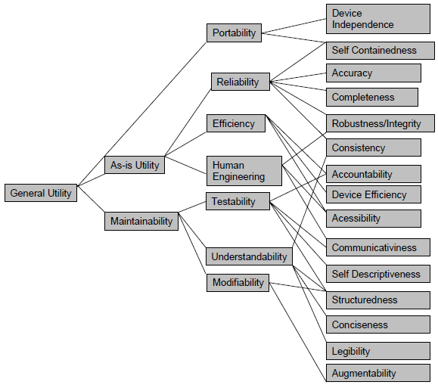

THE BOEHM MODEL

Slide 30
A HISTORICAL PERSPECTIVE OF QUALITY
Evolving perceptions of quality
      Product specifications are specified in terms of ranges and error tolerance, reducing variance in manufacturing has been the focal point of statistical quality control.
      Problems are due to non-conformance to specifications or observed defects defined by the non-conformance
      The average number of reported problems per 100 vehicle by owners during the first three years (they used to count only the first year) of their ownership based on actual survey results.

Slide 31
A HISTORICAL PERSPECTIVE OF QUALITY
Evolving perceptions of quality
      Another commonly used quality measure for automobiles, reliability, is measured by the number of problems over a longer time for different stages of an automobile’s lifetime
      Customer loyalty due to their overall experience with the service
      software industry has incorporated both the conformance and service views of quality, and high-quality software can be defined by three basic elements: conformance, adaptability, and innovation.

